Slide 1
SUPER COMPUTING USING CLUSTER NETWORK
- A supercomputer( HYPE -2 )
Supervisor
Prof. Dr. Subarna Shakya
Santosh Pandey
Ram Sharan Chaulagain
Prakash Gyawali

Slide 2
“HIGH PERFORMANCE
COMPUTING
IS THE
NEED OF
FUTURE TECHNOLOGY”

Slide 3
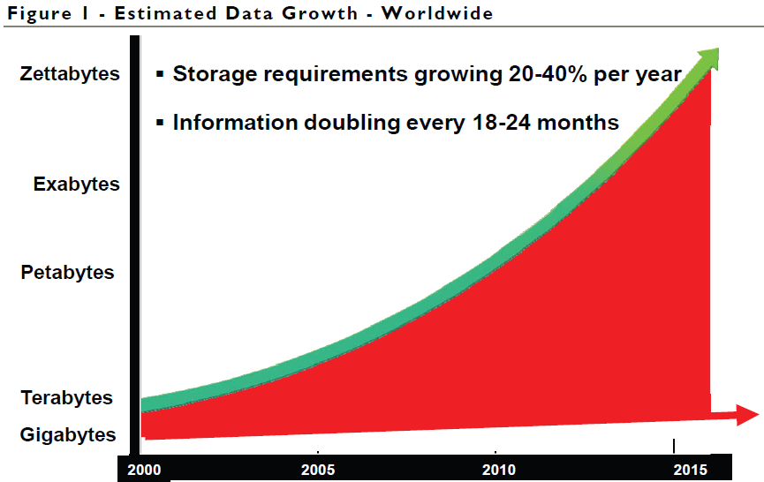
THIS IS JUST THE BEGINNING

Slide 4
MOORE’S LAW

Slide 5
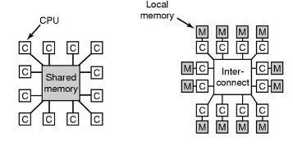
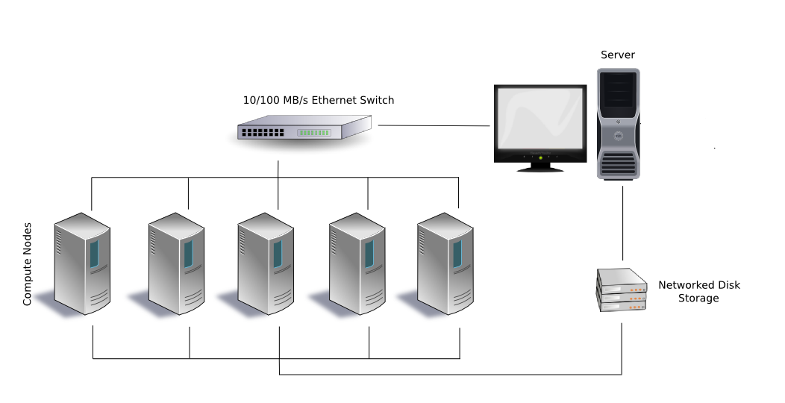
OUR OPTIONS:
MULTIPROCESSOR SYSTEM
MULTICOMPUTER SYSTEM

Slide 6
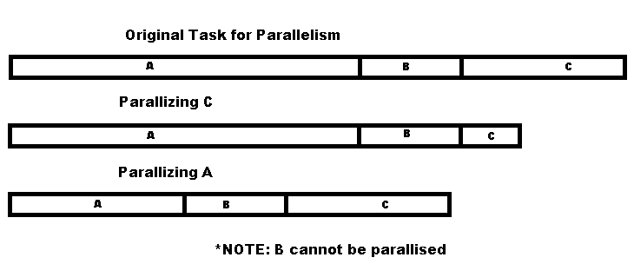
PARALLEL PROCESSING

Slide 7
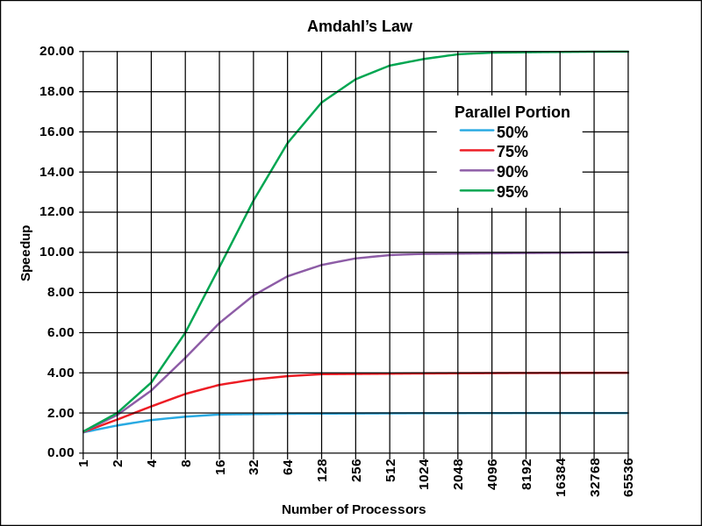
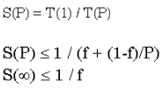
AMDAHL'S LAW
Speedup in multiprocessing
Depends on parallelizable code
S(P)=Speedup on P processors
T(1)=Time to process in 1 processors
T(P)= Time to process in processors
f=Inherently sequential code
p= Parallelizable code

Slide 8
OBJECTIVES
High performance computing for research
Achieving super computing at a cheaper rate than mainframes

Slide 9
History of Supercomputer in Nepal
Muni Sakhya (1980’s)
16 nodes
First and the only one

Slide 10
Not An Application But Self designed High Performance Computing Architecure And Cluster Network

Slide 11
Developing SuperComputing Framework
Middleware
Network Architecture
Multicore Computers

Slide 12
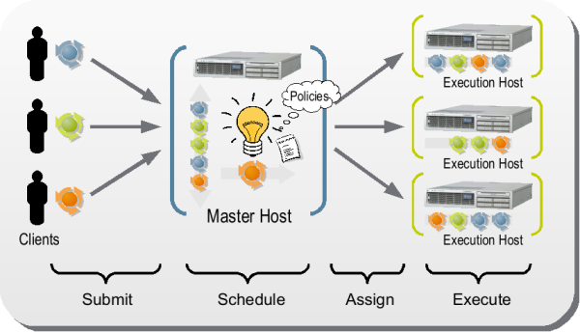
SYSTEM DESIGN

Slide 13
Parallelism Supported By Architecture
SIMD (Single Instruction Multiple Data)
MIMD (Multiple Instruction Multiple Data)

Slide 14
Application Development
Every application don’t have same parallelism model
Specific Applications must be programmed
Extend Methods of our Architecture

Slide 15
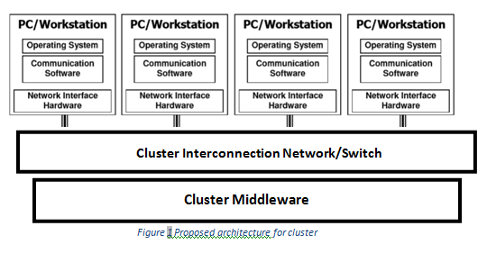
SYSTEM ARCHITECTURE

Slide 16
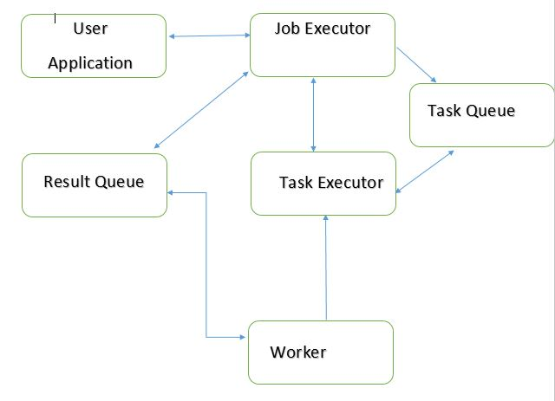
Computational Model

Slide 17
FEATURES OF OUR ARCHITECTURE
Dynamic Worker Addition and Reduction
Fault Tolerant
Scalable System

Slide 18
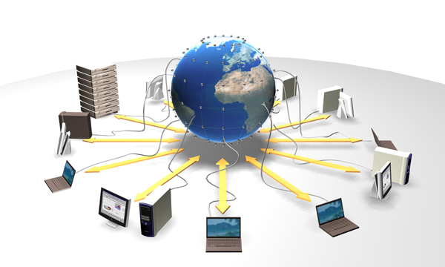
Platform Independent

Slide 19
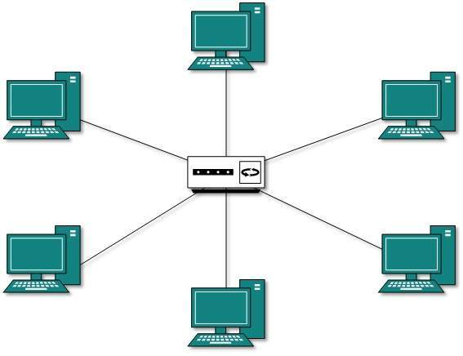
Network Topology
Star Topology

Slide 20
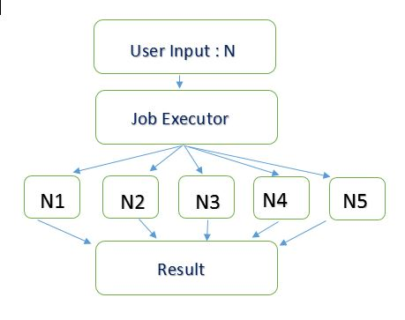
METHODOLGY
Parallel Working

Slide 21

Multitasking Model
Server Thread for each Worker at Server side
New Process for each Worker at Client side
Connect to server
Take chunk to process
Process
Connect to server
Connect to server
Provide output to server
Take chunk to process
Process
Provide output to server
Take chunk to process
Process
Provide output to server
SERVER
THREAD1
Provide Chunk 1 To Client1
THREAD 2
Provide Chunk 2 To Client2
THREAD N
Provide Chunk N To Client N

Slide 22
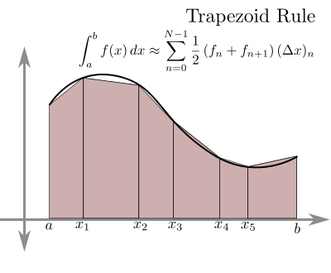
Testing
Running thousands of flops operations
Integration for finding the value of Pi

Slide 23
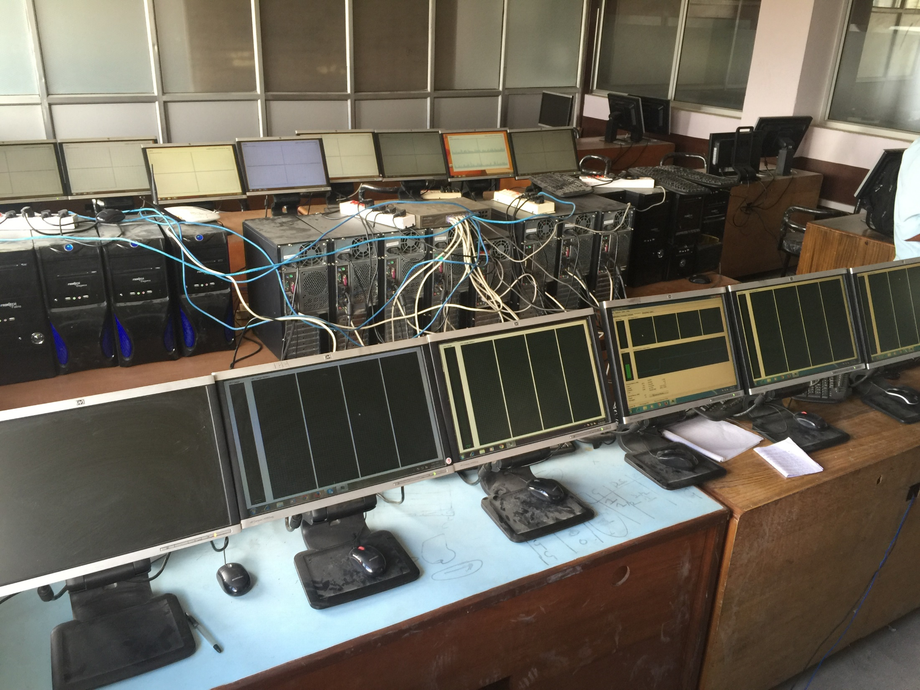
RESULT AND ANALYSIS

Slide 24
RESULT AND ANALYSIS

Slide 25
RESULT AND ANALYSIS(contd..)
Fig : Exponential Speedup

Slide 26
RESULT AND ANALYSIS(contd..)
Theory vs. Practical Data

Slide 27
Comparing in Nepal
No official data for comparing
Probably the fastest in Nepal

Slide 28
APPLICATION
Cryptography
Data Mining
Weather Forecasting
Research
Artificial Intelligence

Slide 29
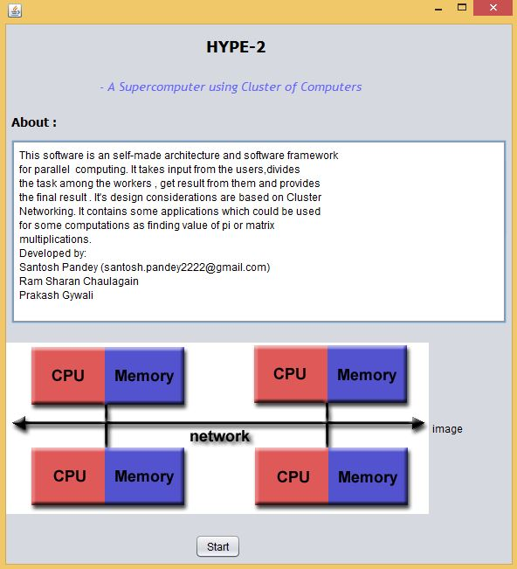

Slide 30
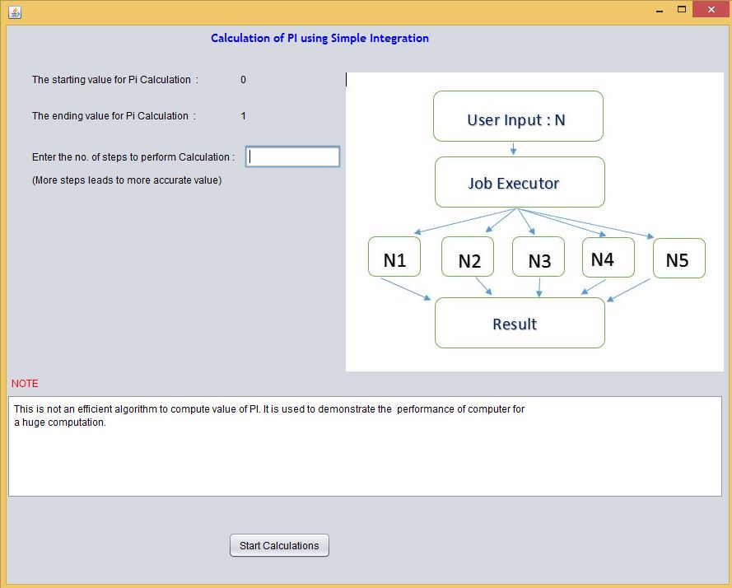

Slide 31
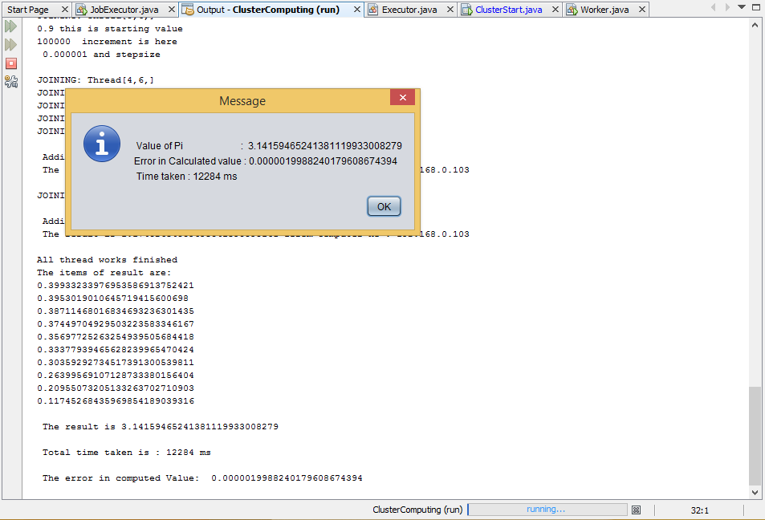

Slide 32
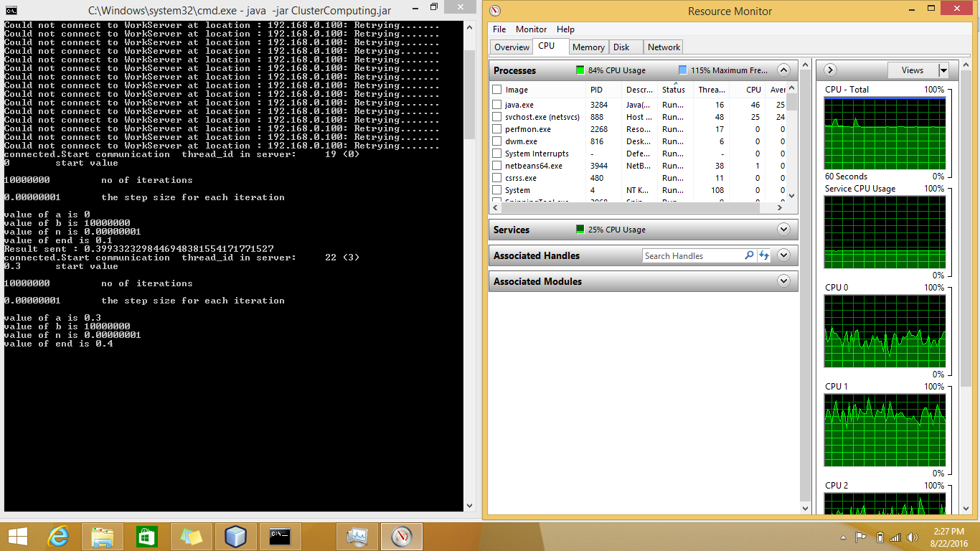

Slide 33
LIMITATIONS
Not comparable with bigger super computer due to less nodes
Extension of Architecture library to define new application

Slide 34
FUTURE IMPLEMENTATIONS
Supporting Complex Computations
Inter-process Communication for dependent tasks
Implementing GPU for Computation

Slide 35
BIBLIOGRAPHY
Websites:
Don Berker. Robert G. Brown. Greg Lindahl. Forrest Hoffman. Putchong Uthayopas. Kragen Sitaker. Frequently Asked Questions [Online]. Available: http://www.beowulf.org/overview.faq.html
Technopedia. Computer Cluster [Online]. Available: http://www.technopedia.com/definition/6581/computer-cluster
Dr. Wu-chun. Feng. (2015). The Green500 list- November 2015 [Online]. Available: http://www.green500/list/green201511
Books:
Shiflet, Introduction to Computational Science: Modeling and Simulation for Sciences, Princeton University Press, 2014.
Kumar, Lenina, MATLAB: Easy Way to Learning, PHI Learning, 2016.
Etter, Introduction to MATLAB, Prentice Hall, 2015
Lemay Laura, Charles L. Perkins, Teach Yourself Java in 21 Days, Samsnet, 1996.

Slide 36
THANK YOU

